Slide 1
CS 2001 Data Structures
Week 2
Lecture 1

Slide 2
Agenda
Limitation of Built-in Arrays in C/C++, Index bounding, safe access, fixed length declaration etc.
Pointer vs. arrays
Defining class of DynamicSafeArray in one dimension
Helping Functions for DynamicSafeArray - constructor, destructor, copy constructor, assignment operator, access operator,

Slide 3
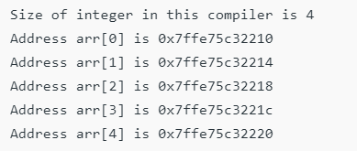
Array Adressing
The elements are stored at contiguous memory locations
#include <iostream>
using namespace std;
int main()
{
int arr[5], i;
cout << "Size of integer in this compiler is "
<< sizeof(int) << "\n";
for (i = 0; i < 5; i++)
// The use of '&' before a variable name, yields
// address of variable.
cout << "Address arr[" << i << "] is " << &arr[i]
<< "\n";
return 0;
}

Slide 4
Limitation of Built-in Arrays in C/C++
Index Bounding: No Index Out of bound Checking:
Safe Access
Allows a fixed number of elements to be entered which is decided at the time of declaration. Unlike a linked list, an array in C is not dynamic.
Insertion and deletion of elements can be costly since the elements are needed to be managed in accordance with the new memory allocation.

Slide 5
